Slide 1
Cybersecurity and Mobile Device Protection
Live Demo: Hijacking an Andorid Smartphone and Compromising Mobile Banking Apps
Dr. Svetlin Nakov
Co-Founder, Chief Training & Innovation @ Software University (SoftUni)
https://nakov.com
Software University (SoftUni) – http://softuni.org

Slide 2
Table of Contents
About the Speaker
Mobile Device Security Threats – The Top 5 List
Live Demo: Hijacking Android Smartphone using TeamViewer Host
Improving the Mobile Device Security: Recommendations and Best Practices

Slide 3
About Dr. Svetlin Nakov
Software engineer, trainer, entrepreneur, inspirer, PhD, author of 15+ technical books
3 successful tech educational initiatives (150,000+ students)

Slide 4
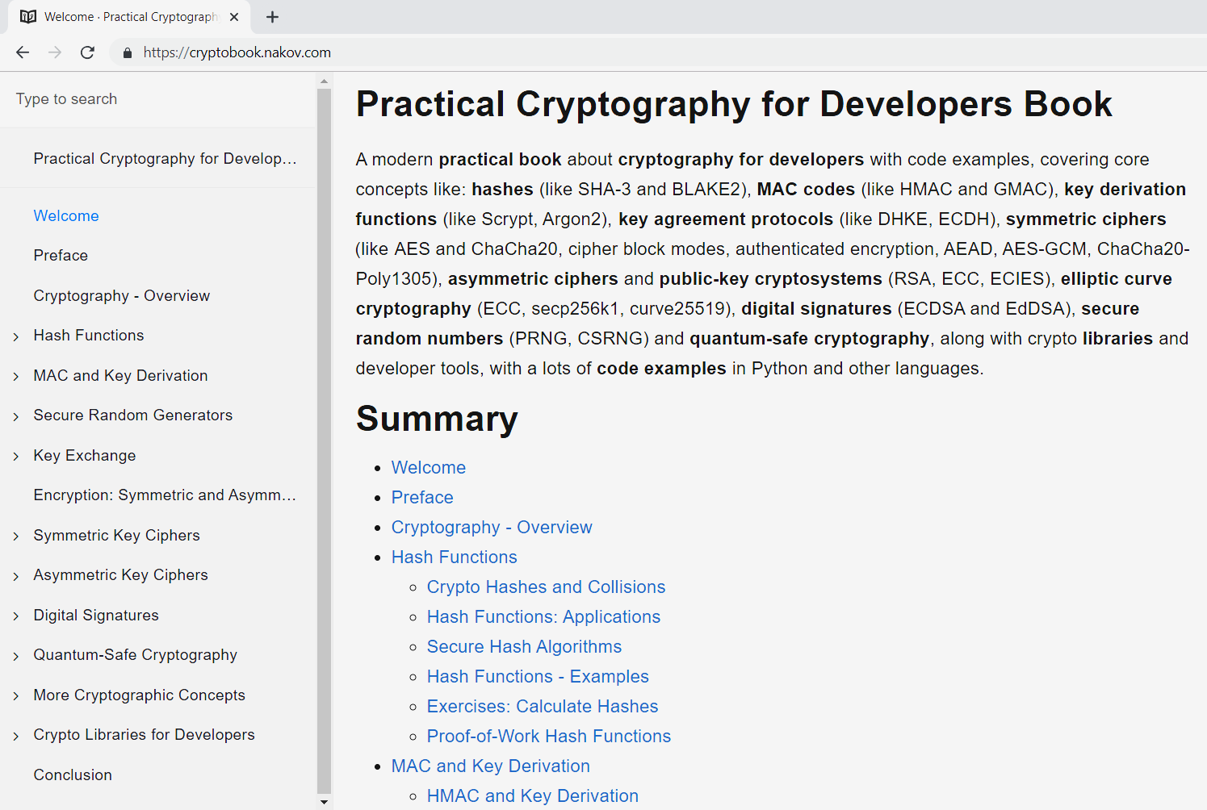
Book "Practical Cryptography for Developers"
Book site:
https://cryptobook.nakov.com
GitHub:
github.com/nakov/practical-cryptography-for-developers-book

Slide 5
Mobile Device Security Threats
The Top 5 List

Slide 6
Mobile Device Security Threats
The top 5 mobile device security threats (Kaspersky Lab, 2019)
Data Leakage – free apps silently collect and leak private data, e.g. for marketing purposes
Unsecured Wi-Fi – fake Wi-Fi routers intercept the traffic and perform man-the-middle attacks (MITM) → collect credentials, install malware
Network Spoofing – trick the network environment to open a fake Web site (looking like legitimate) → collect credentials, install malware
Phishing Attacks – trick the user to open a fake Web site (looking like a legitimate) by emails, ads, chats → collect credentials, install malware
Malware / Spyware – hidden app collects passwords / PIN codes / records screen / controls the device remotely / access mobile banking

Slide 7
Hijacking Android Mobile Phone
Physical access to the device
Attackers directly install remote control app / malware
No physical access
Attackers trick the user to install malware
Fake app in the app store / phishing / spoofing / other attack
Remote control the device (100% full access)
Collect credentials (passwords, PIN codes), impersonate the phone owner, perform everything the phone owner can perform

Slide 8
The following examples are for educational / demo purposes
Secretly hijacking mobile devices is illegal in most countries!
Warning!

Slide 9
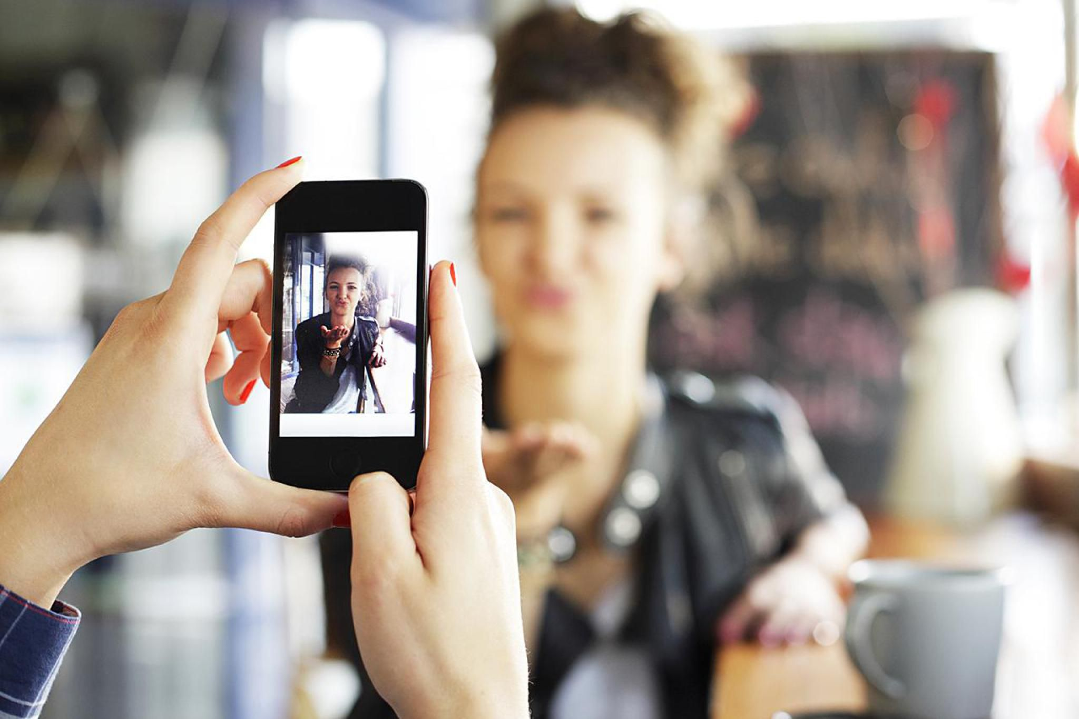
Hijacking Android Mobile Phone – Example
Gain a physical access to the mobile device
E.g. Can you take a photo of me … Can I email myself the photo?

Slide 10
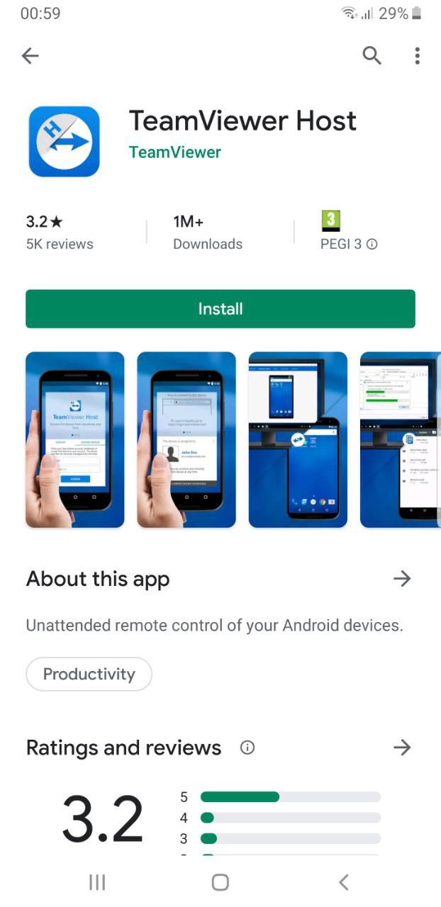
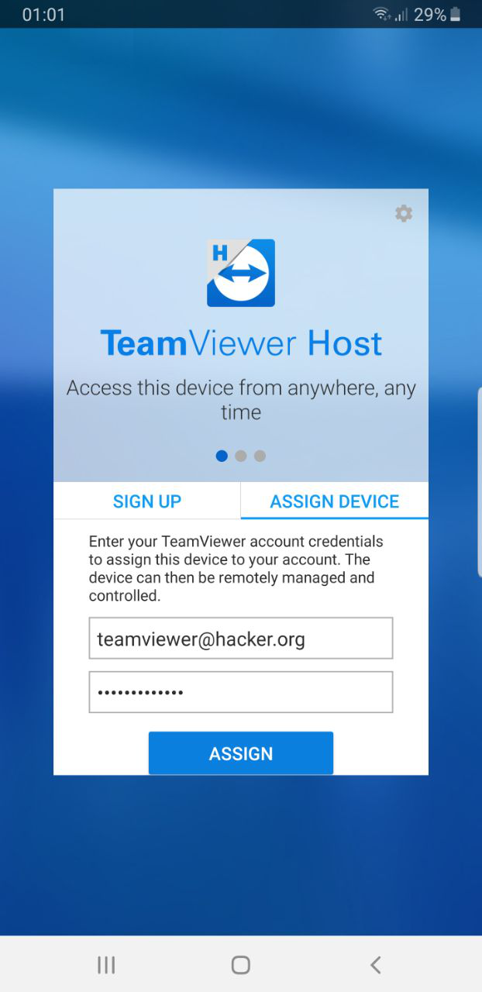
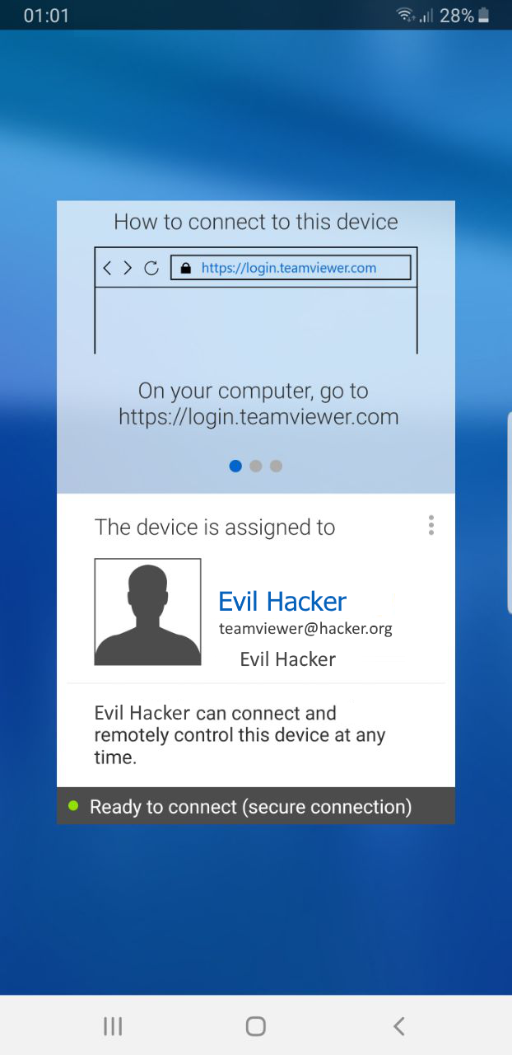
Hijacking Android Mobile Phone – Example
Install TeamViewer Host from the official app store
Login in some TeamViewer account
Now the device is ready to connect

Slide 11
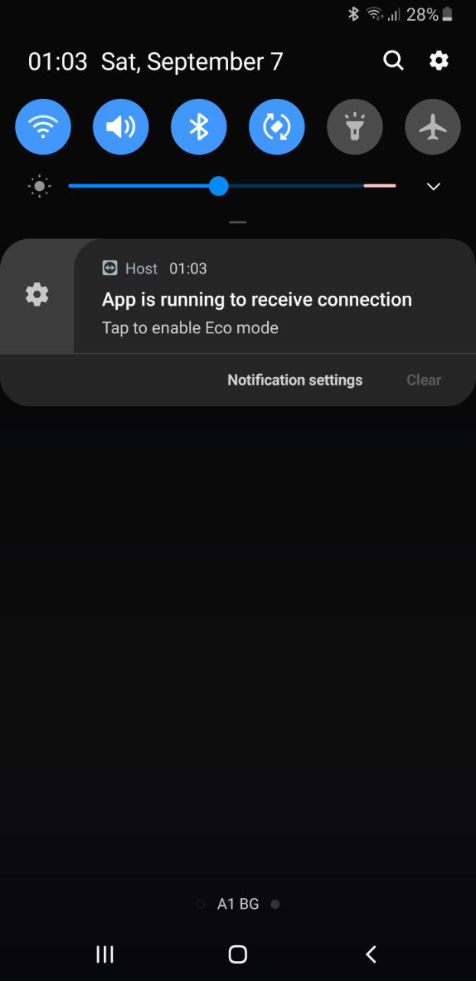
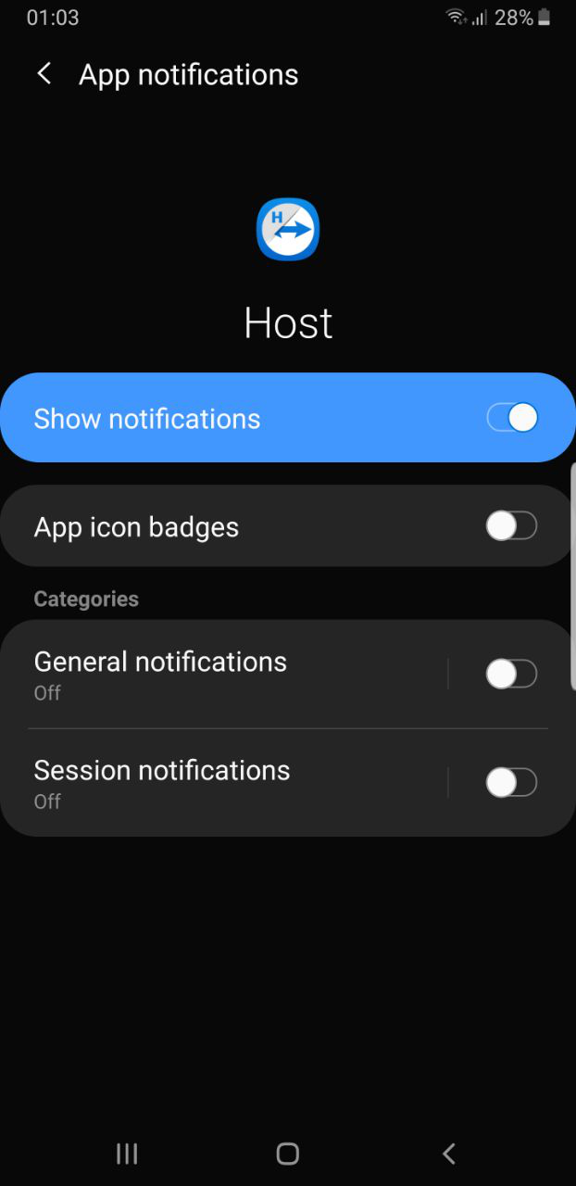
Hijacking Android Mobile Phone – Example
Hide app notifications (optionally)
This will make the remote control invisible for the phone owner

Slide 12
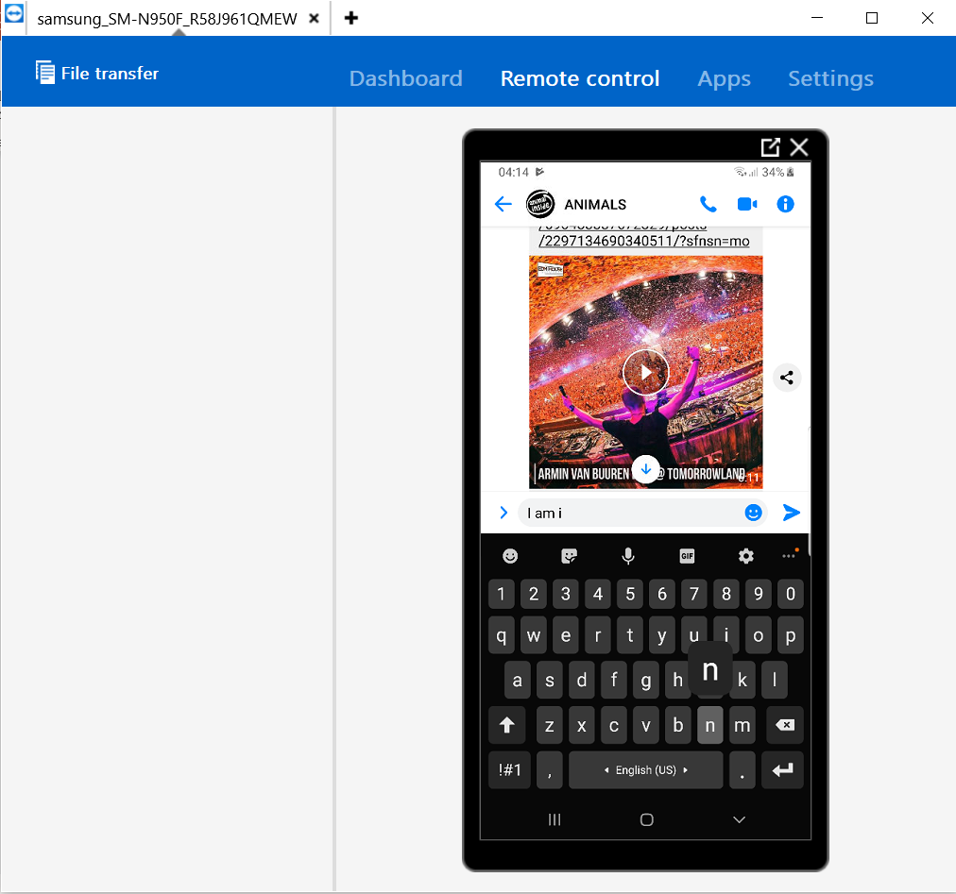
Hijacking Android Mobile Phone – Example
Connect remotely with TeamViewer Remote Control
View the phone's screen and click on it remotely

Slide 13
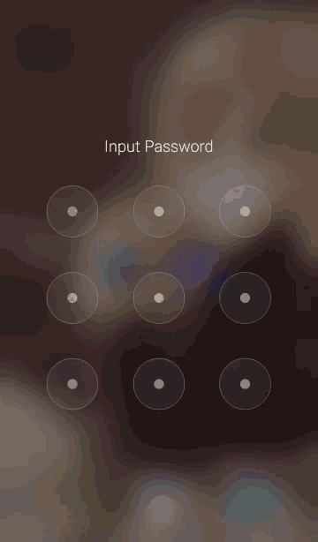
Hijacking Android Mobile Phone – Example
Wait for the smartphone owner to unlock the device
Remember the screen lock pattern
Most smartphones use lock screen
Unlocking is done by screen swipe or with pattern or PIN or biometry

Slide 14
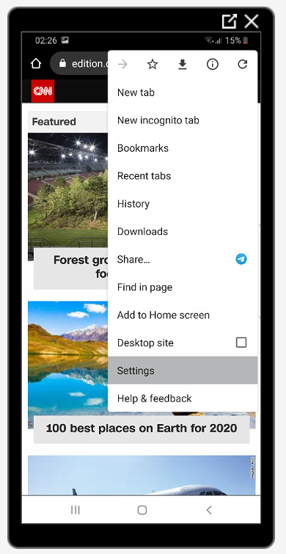
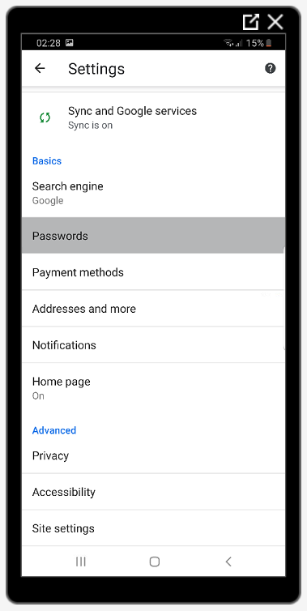
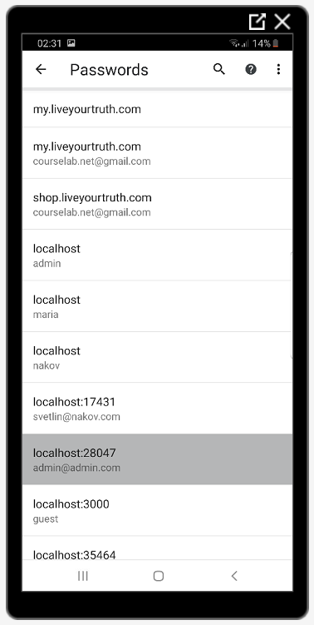
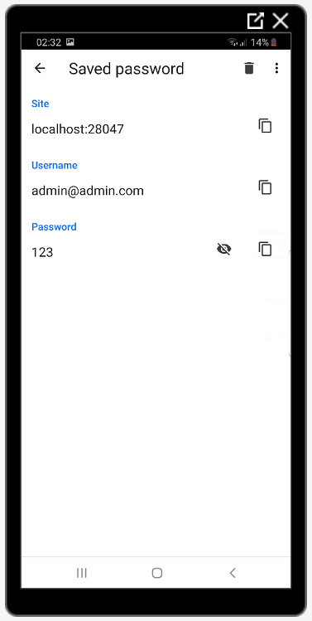
Hijacking Android Mobile Phone – Example
View the saved passwords from the Web browser

Slide 15
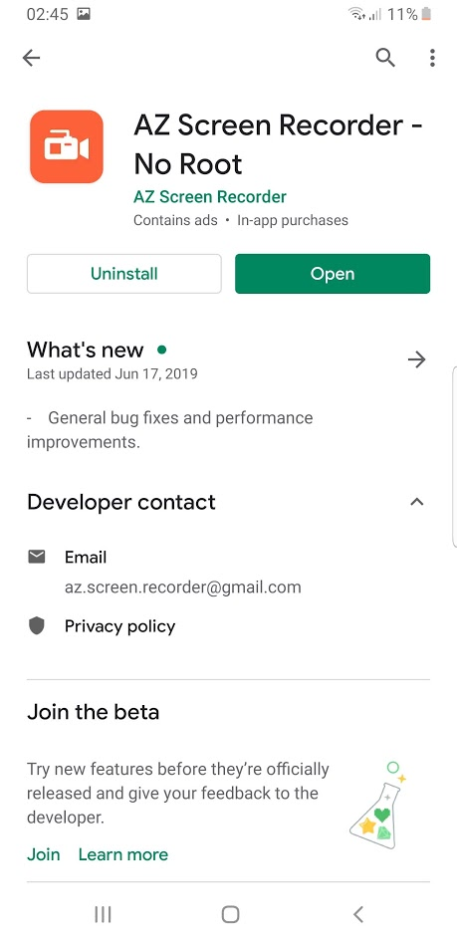
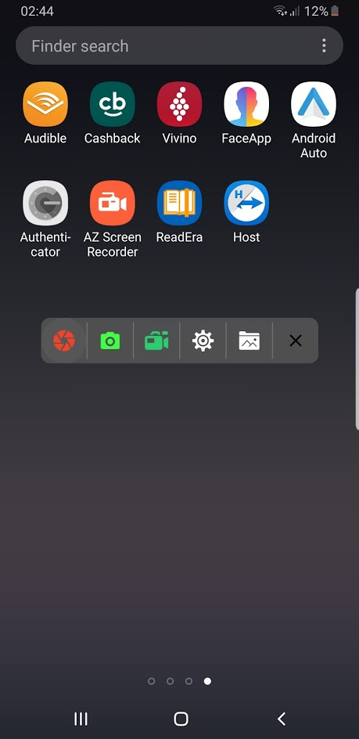
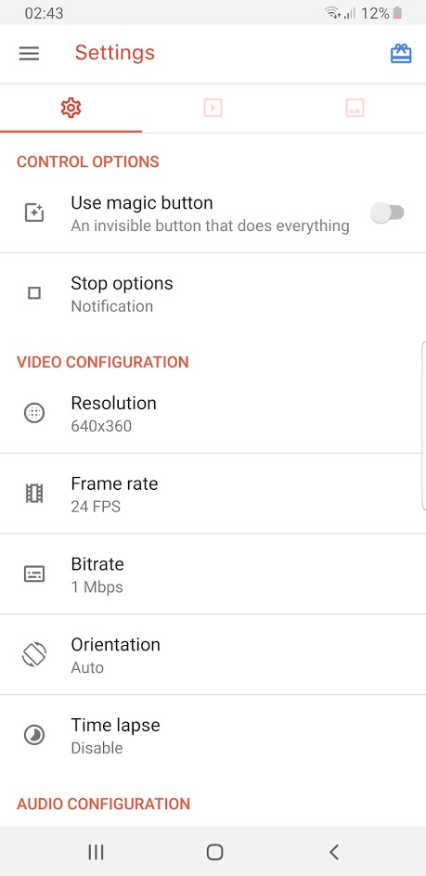
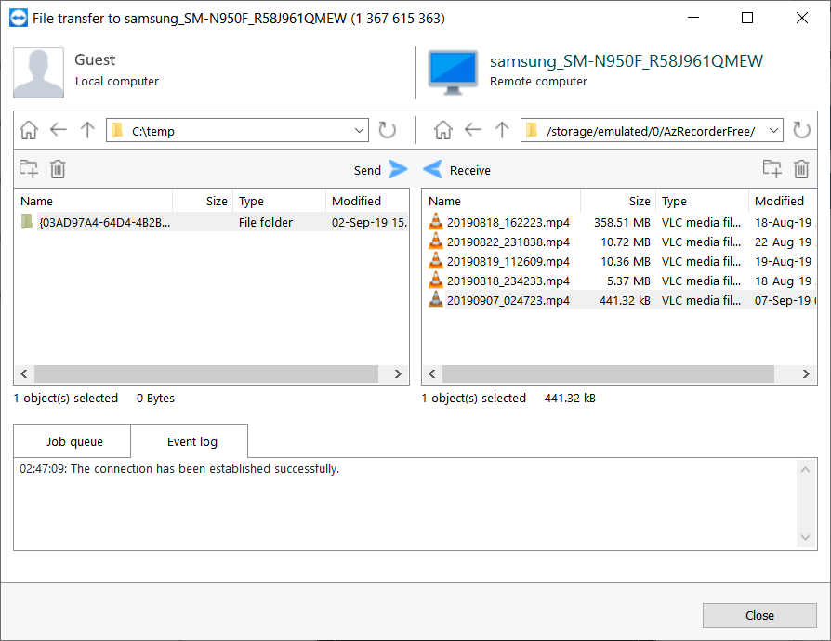
Hijacking Android Mobile Phone – Example
Install a screen recorder to collect passwords and PIN codes through screencast videos

Slide 16
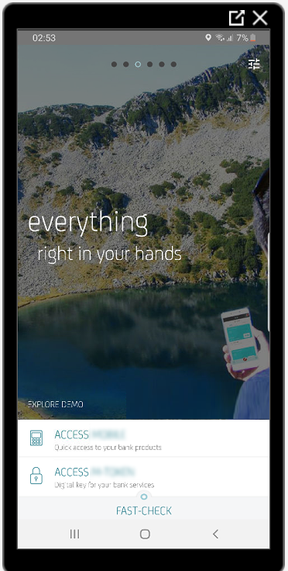
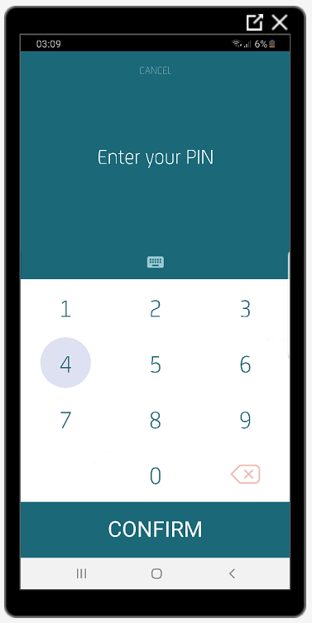
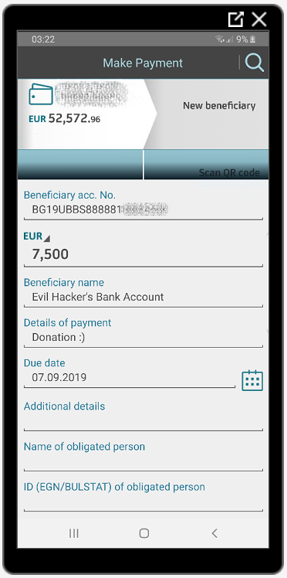
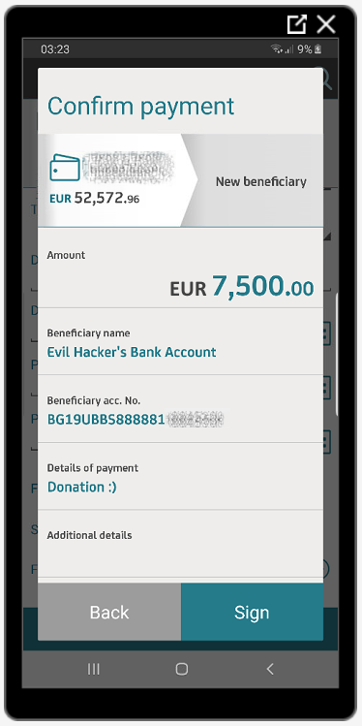
Hijacking Android Mobile Phone – Example
Тhe mobile banking credentials can also be taken

Slide 17
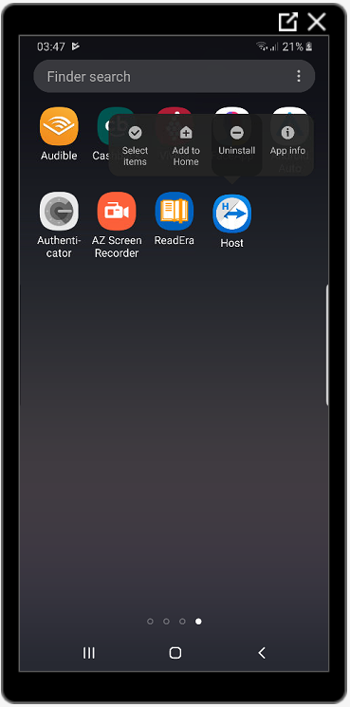
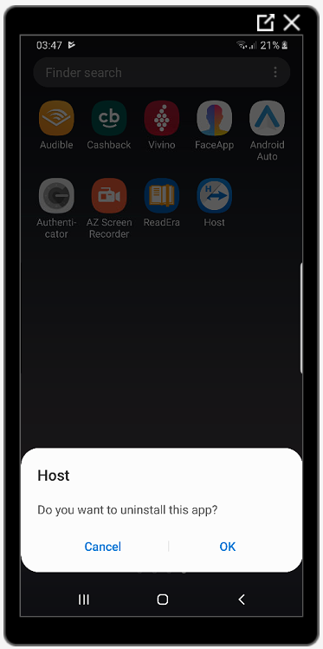
Hijacking Android Mobile Phone – Example
Uninstall TeamViewer Host (hide your tracks, optionally)

Slide 18
Hijacking Android Smartphones
Live Demo

Slide 19
Improving the Mobile Device Security
Recommendations and Best Practices

Slide 20
Improving the Mobile Device Security
Recommendations for improved mobile device security
Beware of apps you install → avoid suspicious apps
Prefer biometry (fingerprint, face ID) to unlock the screen
iOS is generally more secure than Android
iOS does not support remote control (only remote view)
Use two-factor authentication with 2 separate devices (e.g. laptop + smartphone)
Use hardware OTP tokens to access mobile banking

Slide 21
Cybersecurity and Mobile Device Protection
https://nakov.com

