Slide 1
Embracing Digital Disruption …
… with Axxiome Digital
Sofia, 3rd of October 2019

Slide 2
GLOBAL NETWORK, GLOBAL EXPERIENCE
Toronto
Canada
Frankfurt
Germany
Wroclaw
Poland
Munich
Germany
Opole
Poland
New York
USA
Oberwart
Austria
Miami
USA
St. Gallen
Switzerland
Mexico City
Mexico
Buenos Aires
Argentina

Slide 3












MOST BANKS STRUGGLE
TO KEEP UP WITH THE PACE OF CHANGE
IN THE INDUSTRY
z
Disruption and enormous competition
Lack of product differentiation
Customer experiences have new benchmarks
Adapting to evolving market needs and new regulations
Losing customers to banks with more advanced tech

Slide 4
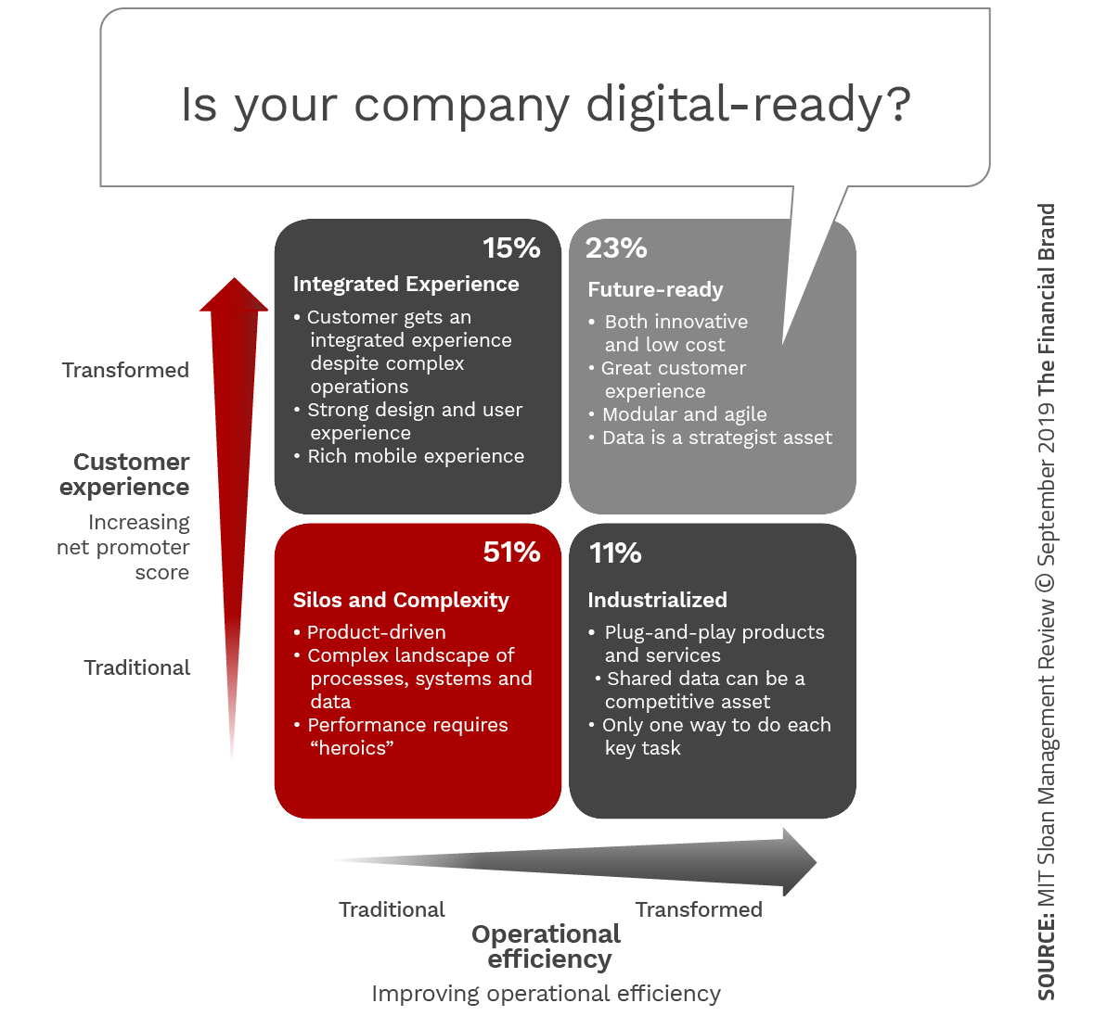
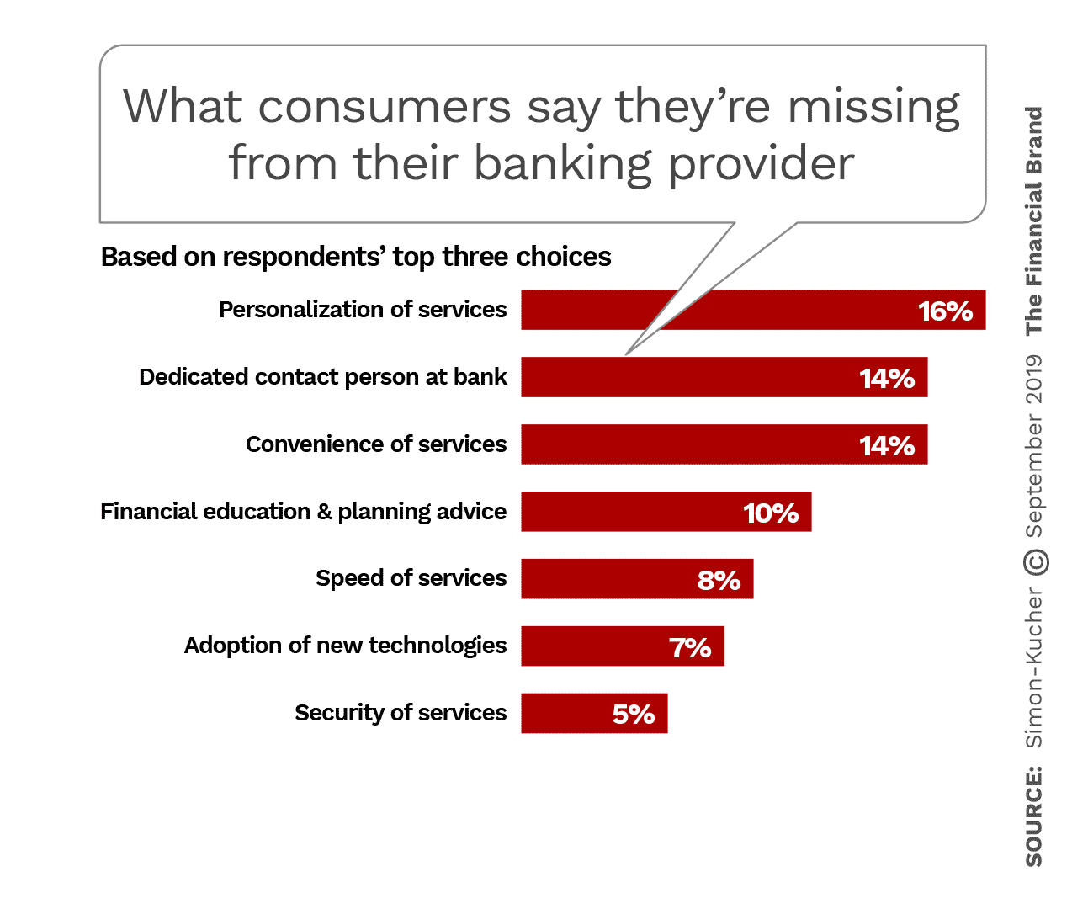
DIGITAL READINESS VS. CUSTOMER EXPECTATIONS

Slide 5












DIGITIZATION OF LEGACY SYSTEMS
LEGACY
Monolithic & rigid
Fragmented
Hardcoded processes
Aging & high maintenance
Limited integration
Data locked out
DIGITAL
Componentized & flexible
Integrated
Customizable & extensible
Future-ready & efficient
Open APIs & hyper connectivity
Data on-demand
PLATFORM

Slide 6
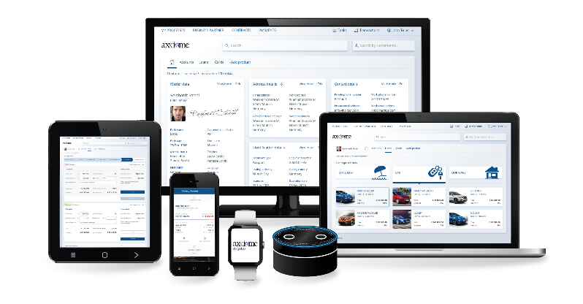
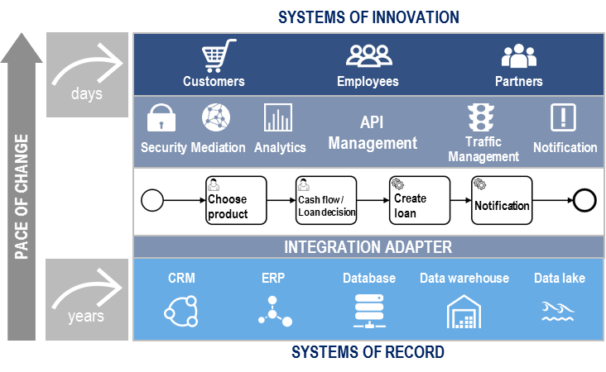
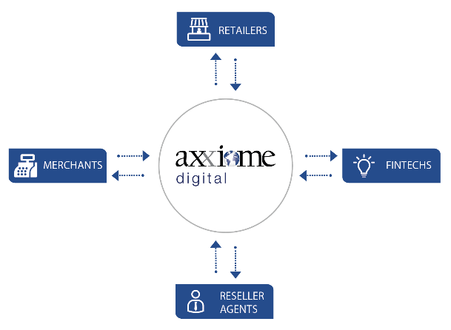

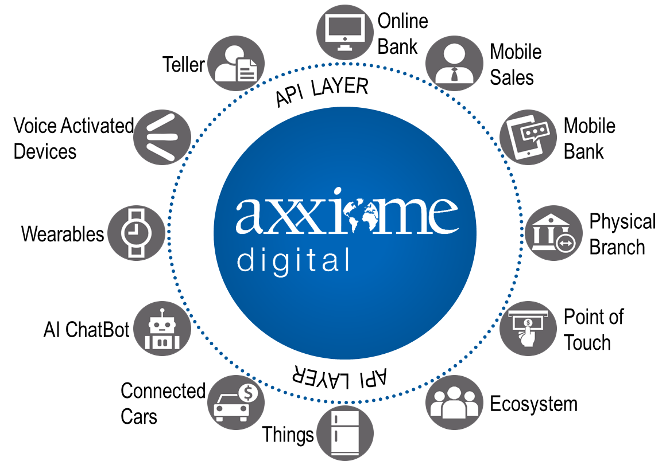







ONE PLATFORM, MANY USE CASES
Axxiome Digital - Processes
Customer
& Accounts
P
Product
Origination
P
Loans
Decision
P
Teller
& Cash
P
Corporate
Banking
P
Loans
Services
P
Product Catalogue
P
+ more
P
Any channel, any device, any time.
Improve customer experience with omni-channel capabilities.
It’s not just the technology, it’s also the content.
500+ industry-standard processes available out-of-the-box.
Accelerate digital transformation.
Two-speed architecture in Axxiome Digital ensures
powerful transformation and optimal results.
UI
Processes
Adapter
Backend
Process management & operations efficiency in the digital age.
Connect the dots!
PSD2 compliance. Open Banking. Collaboration with FinTechs.
One platform, many use cases.
Fast go-to-market.
Expose new products across channels in hours.
Introduce innovative,
value-added products.
Because customers always deserve more.

Slide 7
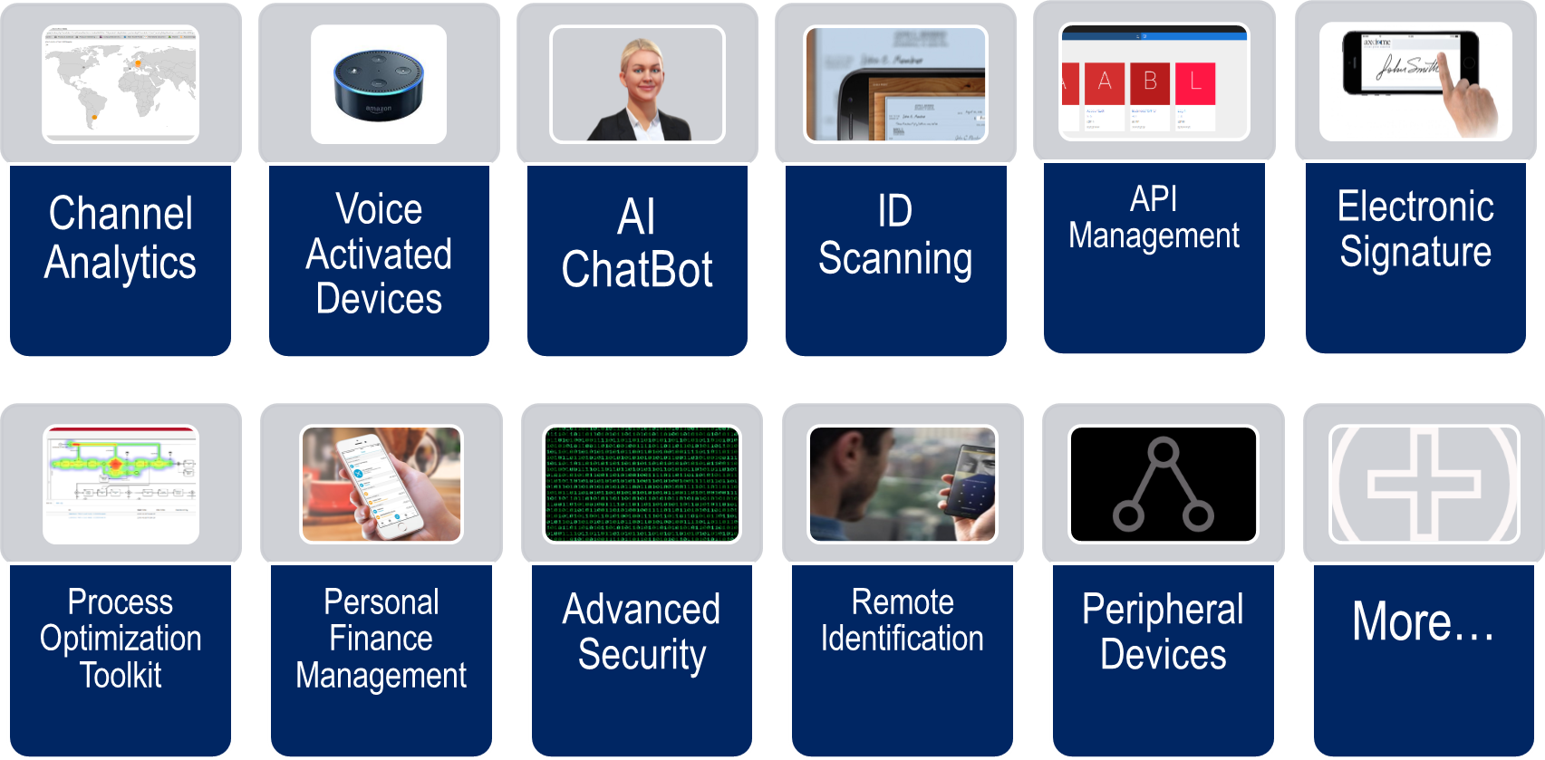
INNOVATION AND DIGITAL CAPABILITIES
We developed a network of partners that provide us with state of the art solutions to provide the best digital experience to anyone using the platform, them being bank employees or the banks’ end customers…

Slide 8

AXXIOME DIGITAL – PLATFORM FOR DIGITIZATION
Simplified, customer centric banking.
Deliver exceptional customer experience while improving day-to-day operations.
Enables banks to optimize
their operations through
omnichannel capabilities,
simplified processes
and integration
Axxiome Digital - Channels
„
EMPLOYEE DRIVEN CHANNELS
CUSTOMER DRIVEN CHANNELS
Online
Banking
Customer
Service
UI
UI
Teller &
Cash
UI
Mobile
Sales
UI
Mobile
Banking
UI
Voice
Banking
V
Axxiome Digital - Digital Add-Ons
Secure
Video Ident
D
Virtual Assistant
D
Personal Finance Mgmt
D
+ more
D
Axxiome Digital - Foundation
Omni
Channel Mgmt
F
Product
Configurator
F
Open Banking APIs
Business
Process Mgmt
F
Business
Rules Mgmt
F
Axxiome Digital - Processes
Provides an agile, flexible
framework to meet current
and future challenges
Customer
& Accounts
„
P
Product
Origination
P
Loans Decision
P
Teller &
Cash
Basic
Security Mgmt
P
F
Adapter
F
Corporate
Banking
P
Cards Management
P
Product Catalogue
P
+ more
Peripherals
Mgmt
P
F
+ more
F
Backend
Legacy Systems
3rd Parties
Core Systems
Devices
…

Slide 9



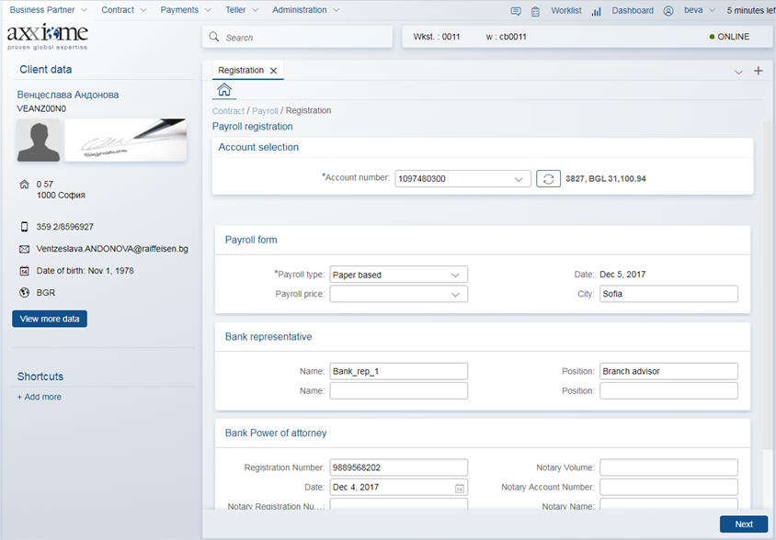
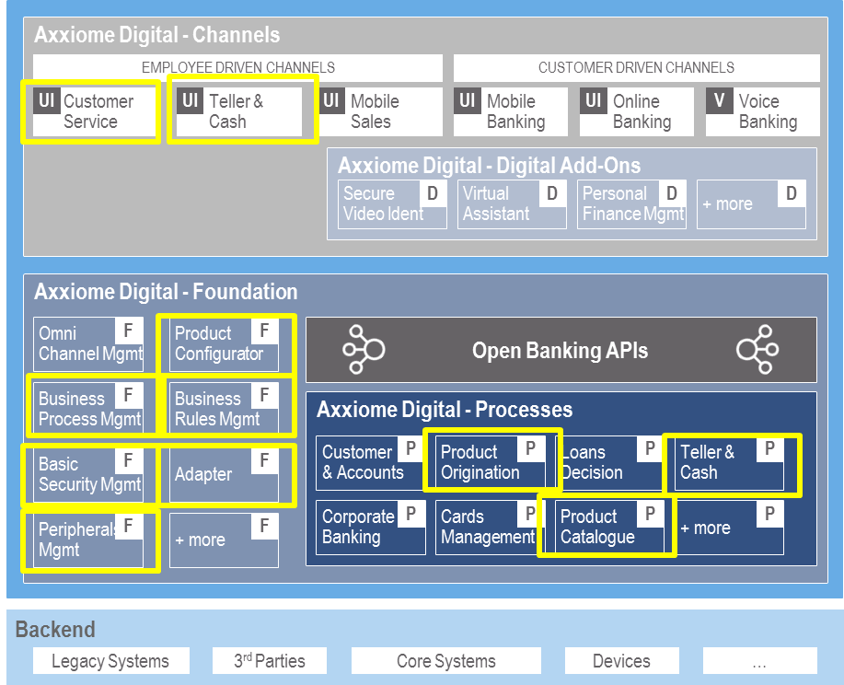

USE CASE
THE CLIENT
Raiffeisenbank (Bulgaria)
RAIFFEISENBANK BULGARIA:
?
THE WHYS
Digitalization of the branches
Simplification and efficiency improvement of the branch processes
Avoidance of manual errors
Sophisticated management of new products and pricing for all the LoBs of the Bank
Individual pricing management for all client types (retail, private and corporate)
THE SOLUTION
Axxiome Digital: Teller & Cash
Axxiome Digital: Product Sales Solution
Axxiome Digital: Product Catalog & Pricing Solution

Slide 10

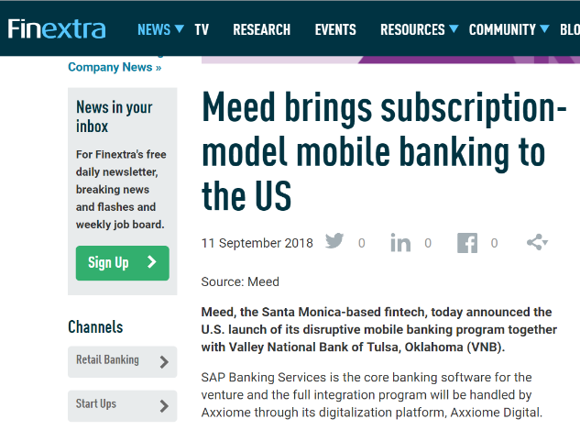
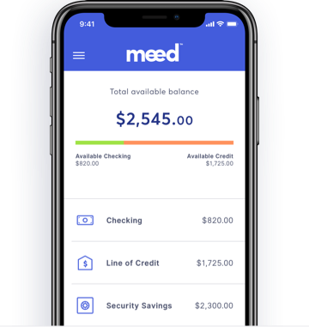

USE CASE
THE CLIENT
Headquartered in Santa Monica, CA, Meed is on a mission to make financial services more affordable, convenient and aligned with the needs and behaviors of digital consumers
Meed provides a new global platform for a community of networked Member Banks, Corporate Members and individual users
MEED – FINTECH | USA:
Banking made surprisingly simple, with Axxiome and SAP
?
THE WHYS
Deliver a digital banking experience to Meed with no requirement for branch interaction
THE SOLUTION
Linked checking, savings and credit accounts
Domestic and international transfers
Unique income-building SocialBoost™ program
Since many US Banks are struggling with old Architecture
and technology limiting their ability to integrate to new
services/FinTechs, this full End-to-End banking
transformation will be ground breaking in the US with
huge potential for similar projects in the future

Slide 11
THANK YOU
Bruno Canettoli
bruno.canettoli@axxiome.com

