Slide 1
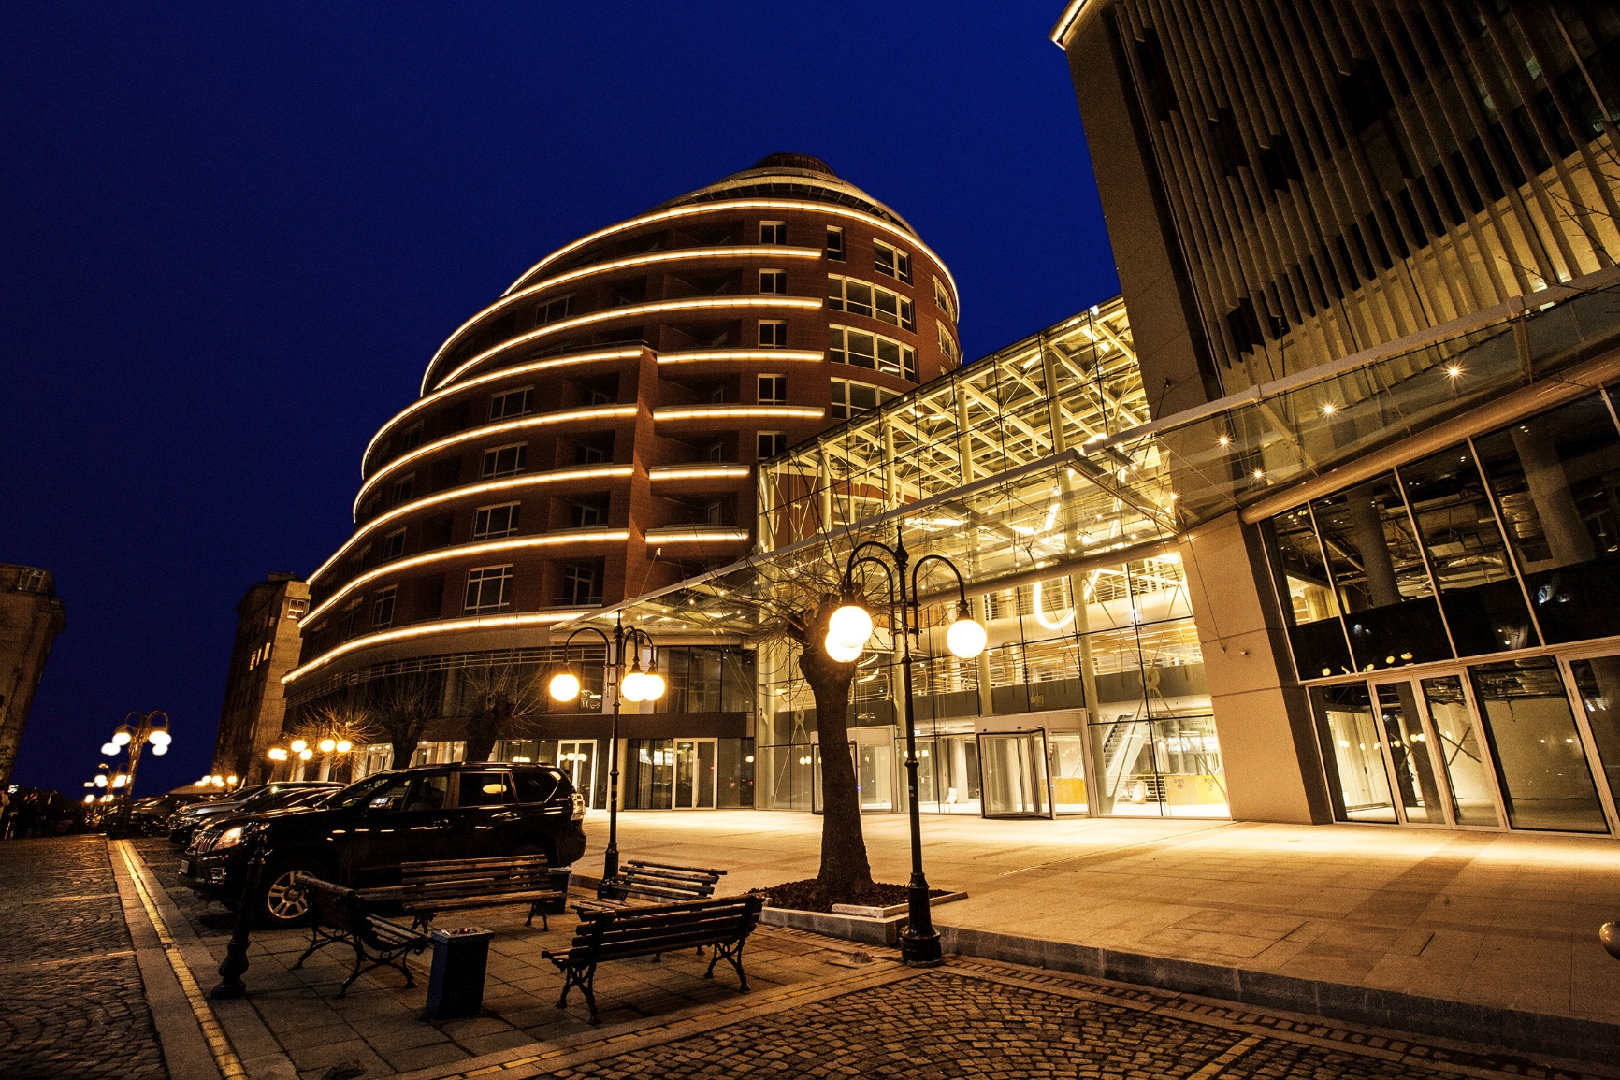
Cyber Protection
for the Digital World
Dual headquarters in Switzerland and Singapore

Slide 2
Acronis is a Singaporean-Swiss Company, a Global Business, and the World Leader in Cyber Protection
Singapore
Schaffhausen, Switzerland
Solar system
Founded in Singapore by a Singaporean in 2003
Established its second HQ in Switzerland for its global expansion in 2008
Global company with more than 1,400 employees in 32 locations worldwide
Rapidly Accelerating
30% overall growth in 2019
200% Cloud growth in 2019
40%+ accelerating growth in 2020
80% of Fortune 1000 companies use Acronis products and services 50,000+ partners • 500,000+ businesses • 5,000,000+ prosumers in 150+ countries

Slide 3
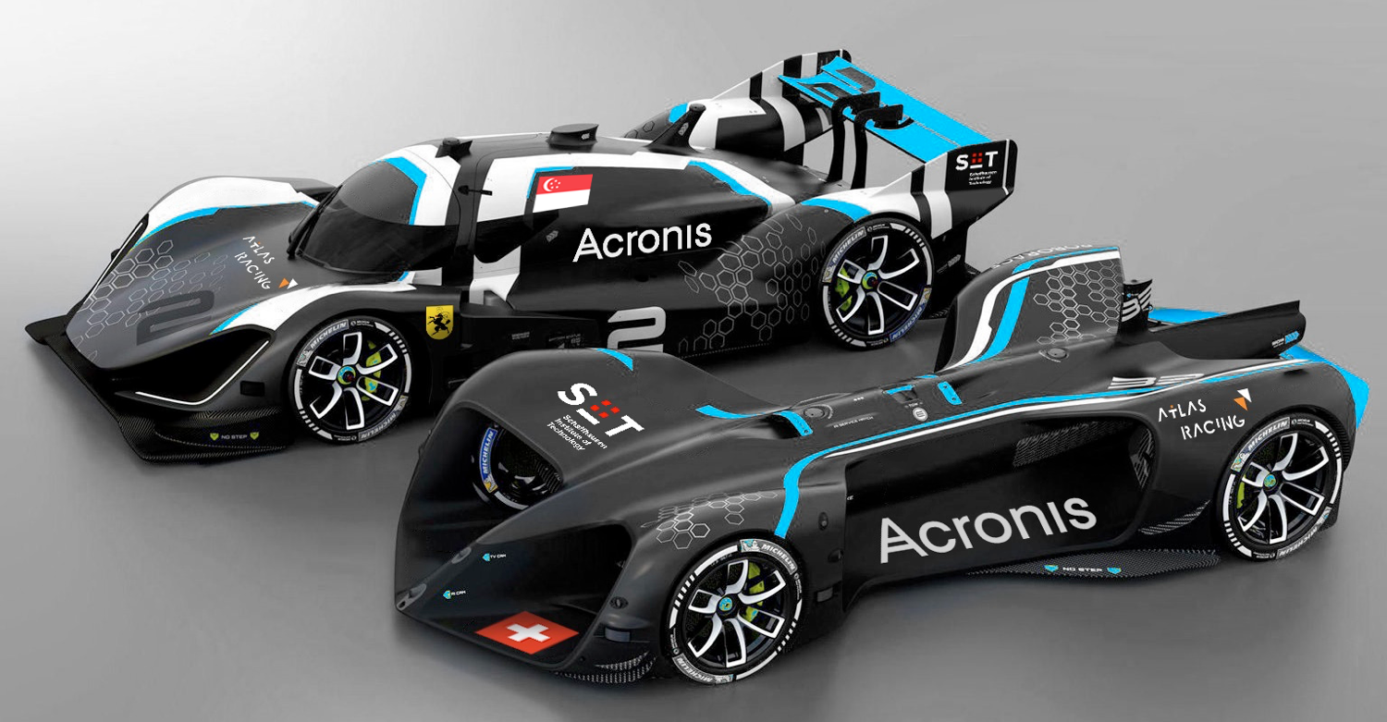
The World is Digital
1
2
3
4
5
6
Self-Driving Cars
Internet of Things
Robots
Drones
3D Printers
Next Gen Computing
Productivity
7
8
9
Fintech
Big Data
Bitcoin
Finance
10
11
12
13
14
Wearables
Virtual Reality
Life Sciences
Blockchain
Space Exploration
Basic Needs
15
16
17
Artificial Intelligence
Safety, Security, Privacy
Quantum Technologies
Meta-trends
Roborace Season Alpha Competitions – 2019

Slide 4
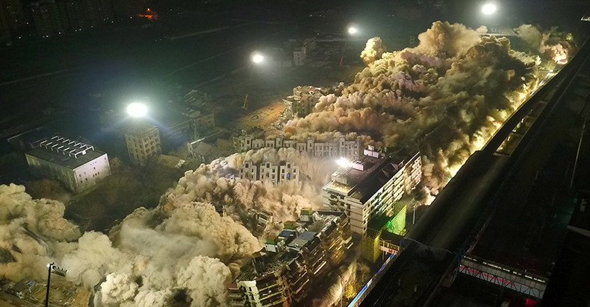
Digital World Needs Protection Bits are easy to copy and destroy
Wiping 1 PB of data requires 0.0001 J
Demolishing a building requires 1,000,000,000 J
Copying physical precisely is impossible
Demolishing 19 buildings in China, 5 ton TNT, 19 buildings

Slide 5
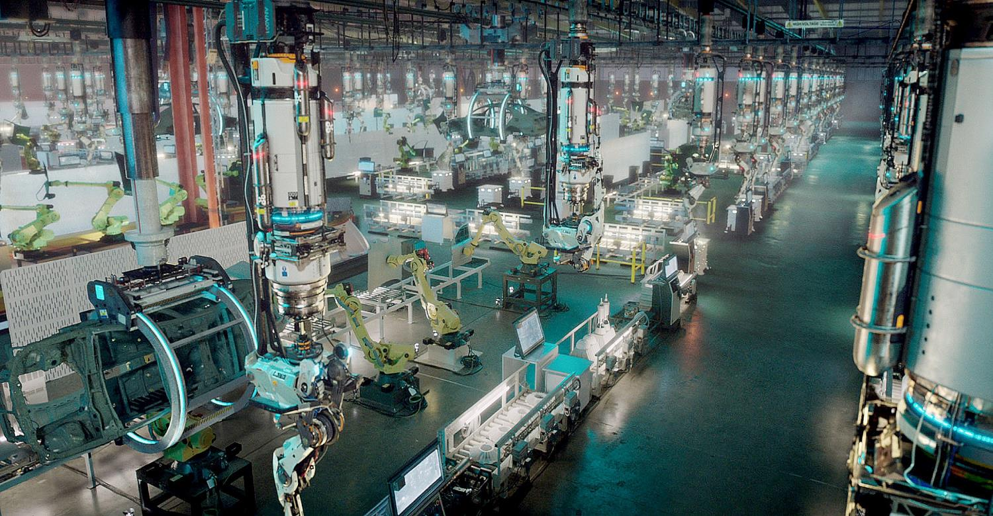
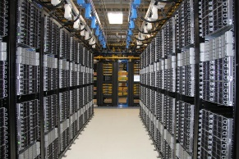
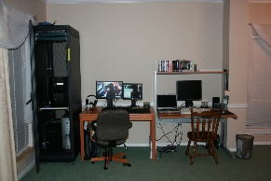
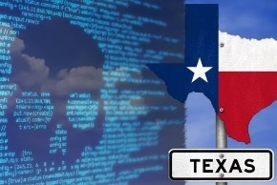
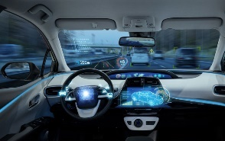
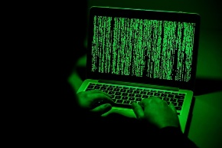
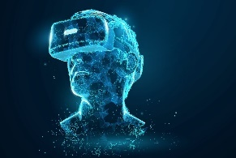
Digital World Protection Challenges: Complexity, Security, Cost outside of the Core (Cloud & Large DC)
Complexity: Ultra Rapid Growth in # of Systems
100B Devices, 1-2B of them the Core – most Edge/Endpoints
(Source: IDC)
Security: Threat Trends
Industrialization and Automation of Cyber Crime, Zero-Day Exploits, Forensic
Cost: Ultra Rapid Growth of Data and Accelerating
Over 40 ZB in 2019, growing to 175 ZB (or much more) by 2025
(Source: IDC)
CORE
Large datacenters, public and private cloud
Government of Bulgaria records stolen
Internet of Things, satellites, healthcare and wearables
1
EDGE
Branch offices, remote locations, factories
Government of Texas hit by ransomware
Autonomous machines, drones and robots
ENDPOINT
Computers, phones, various devices
One million Swiss residents are victims of cyber attacks
Computer vision, virtual and augmented reality
Source: IDC
AI-controlled factory from ANA short movie - https://youtu.be/_2-EQLZ8hO4

Slide 6
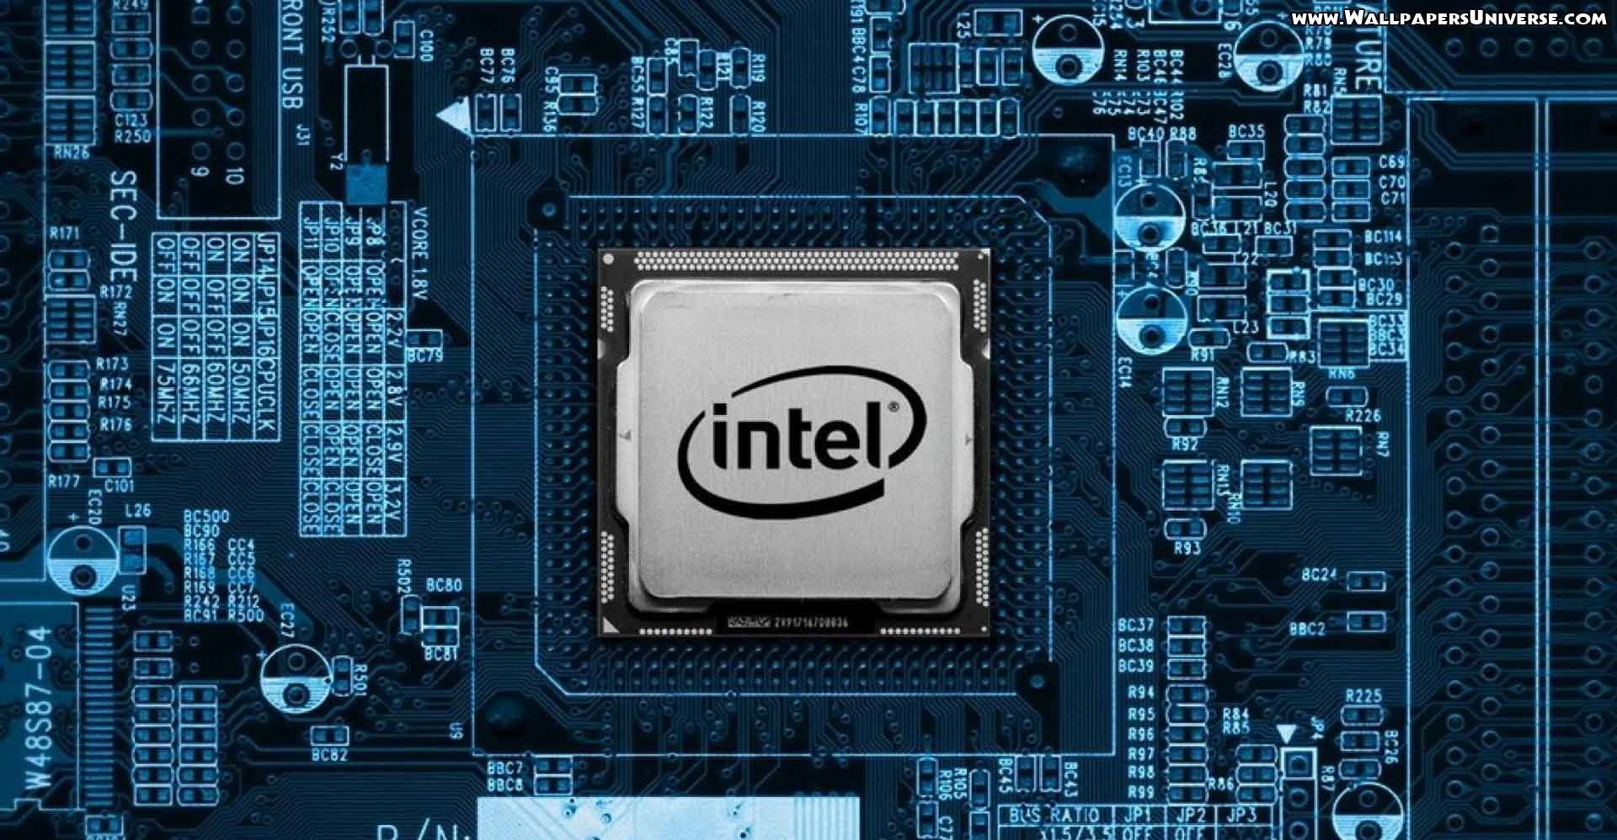
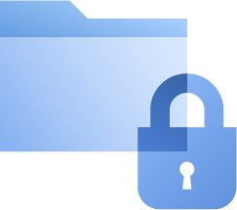
Cyber Protection for the Digital World
Safety
Accessibility
Privacy
Authenticity
Security
Data Protection
Cyber Security
Cyber Protection

Slide 7
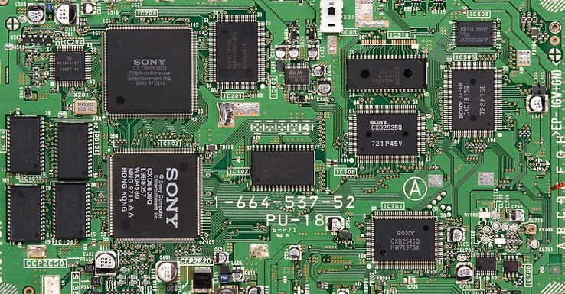
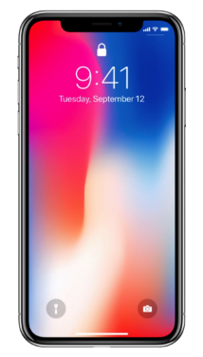
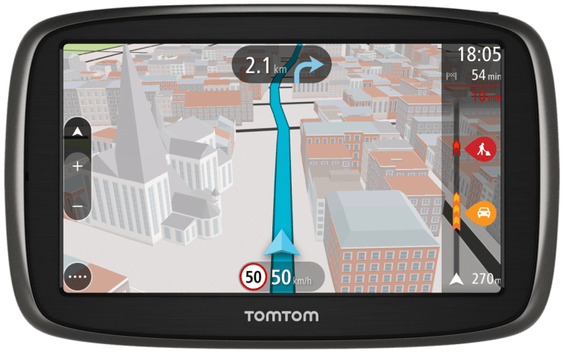
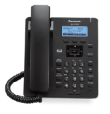
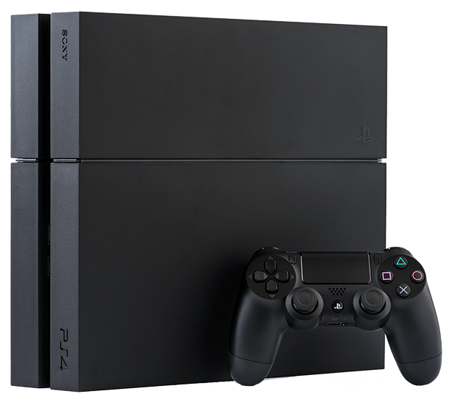
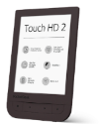
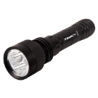
Implementation of Cyber Protection Five Levels of Integration
1. Business integration Sales and marketing bundle of products
2. User interface integration Unified user interface between products
3. Management integration Common management and policies
4. Product integration Products exchange information
5. Technology integration Complete integration

Slide 8
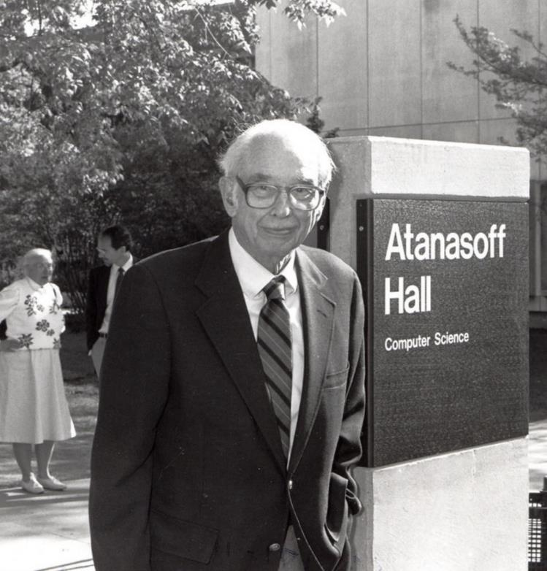
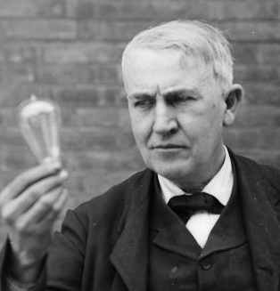
Acronis Innovations for Cyber Protection
AnyData Technology
Reliable protection for any workload in any environment
Acronis Cyber Infrastructure
Scale-out cost-efficient multi-purpose software-defined infrastructure
Hybrid Cloud Architecture
Full control and flexibility for managing data, applications and systems
Blockchain
Distributed crypto architecture for authenticity and privacy control
Artificial Intelligence
Behavioral security, automatic data classification and sorting, autonomous operations, and more
300+ patents issued and pending
John Vincent Atanasoff
Thomas Edison

Slide 9
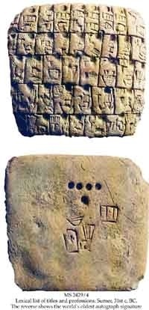
Acronis Authenticity
Digital Identity Powered by Blockchain Technology
Certification
Timestamping
Signing
Verification
Identification
Acronis Notary
Smart Notarization
Multi- eSignatures
Verification and Data DNA
Zero-Trust Consortium
Person and
Document
Identification
The Earliest Autograph Signatures. Circa 3100 BCE
Reconstruction of the Sacred Precinct at Ur, circa 21st century BC.

Slide 10
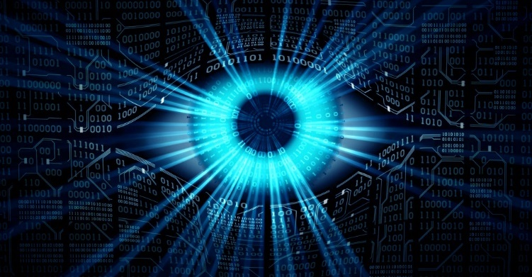
Acronis Cyber Security
Using integration with Data Protection and AI
Prevention
Detection
Response
Recovery
Forensics
Unique features of Acronis Security
Smart protection plans based on Acronis threat alerts
AI/ML based threat detection
and behavior analysis
Attack response with complete AI assisted visibility on the edge
Attack remediation without data loss with integrated patching
Fast and precise investigation with forensic-rich backups

Slide 11
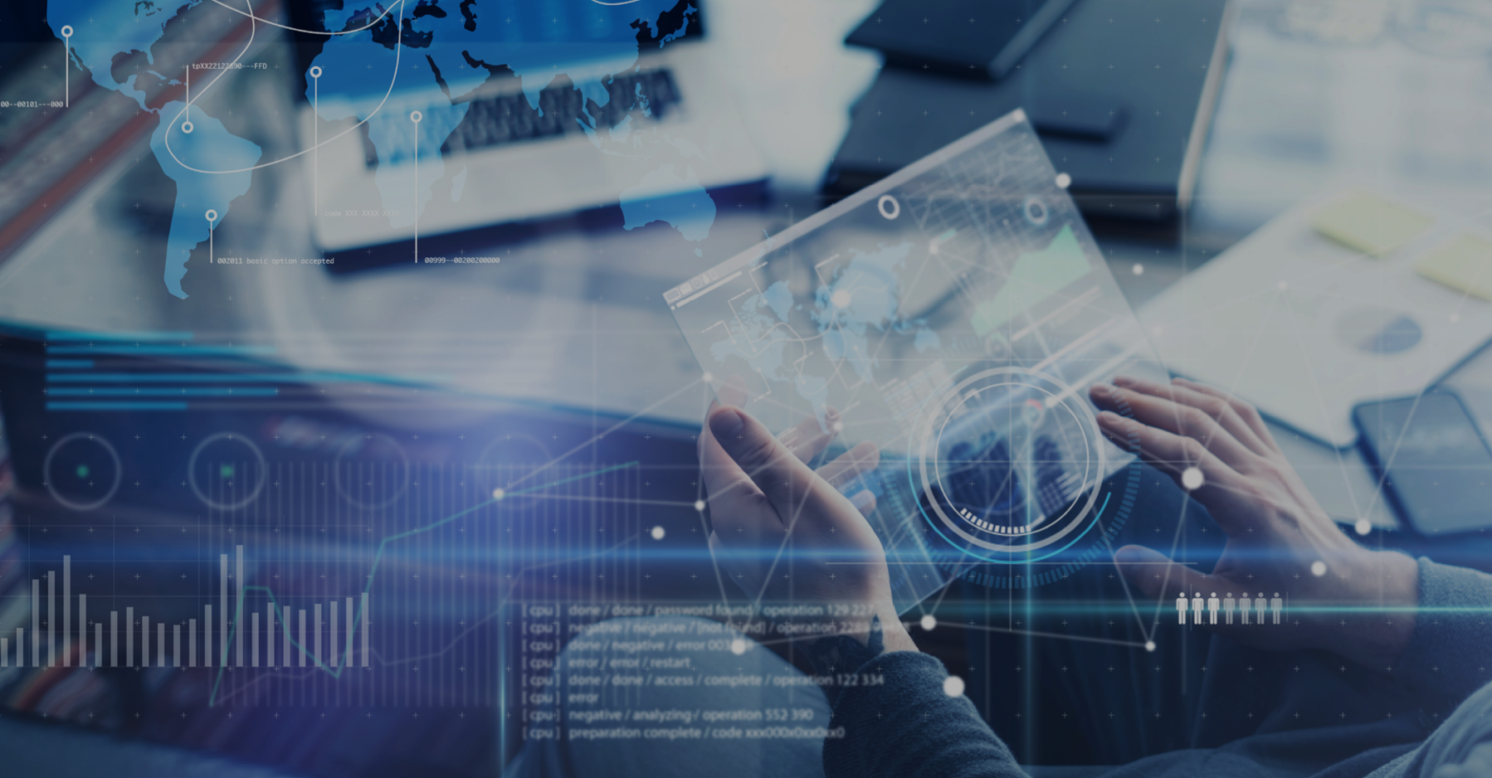
Secure Data Management for Enterprise Single Platform for Datacenter, Edge and Cloud Services
Business Continuity
Global Search
Automated Protection
Real-time Analytics
Policies and Compliance
Acronis “Cyber Protected” Data Management
Instant restore of backup images as virtual machines in cloud or on-premises for near zero recovery time
Google-like search across entire infrastructure; real-time data indexing during ingestion
Group policies for physical and virtual machines; auto-discovery and configuration based on SLA
Dashboards with data analytics, real-time notifications and guidance for IT staff to address issues
Data location, replication and retention policies based on enterprise compliance requirements

Slide 12
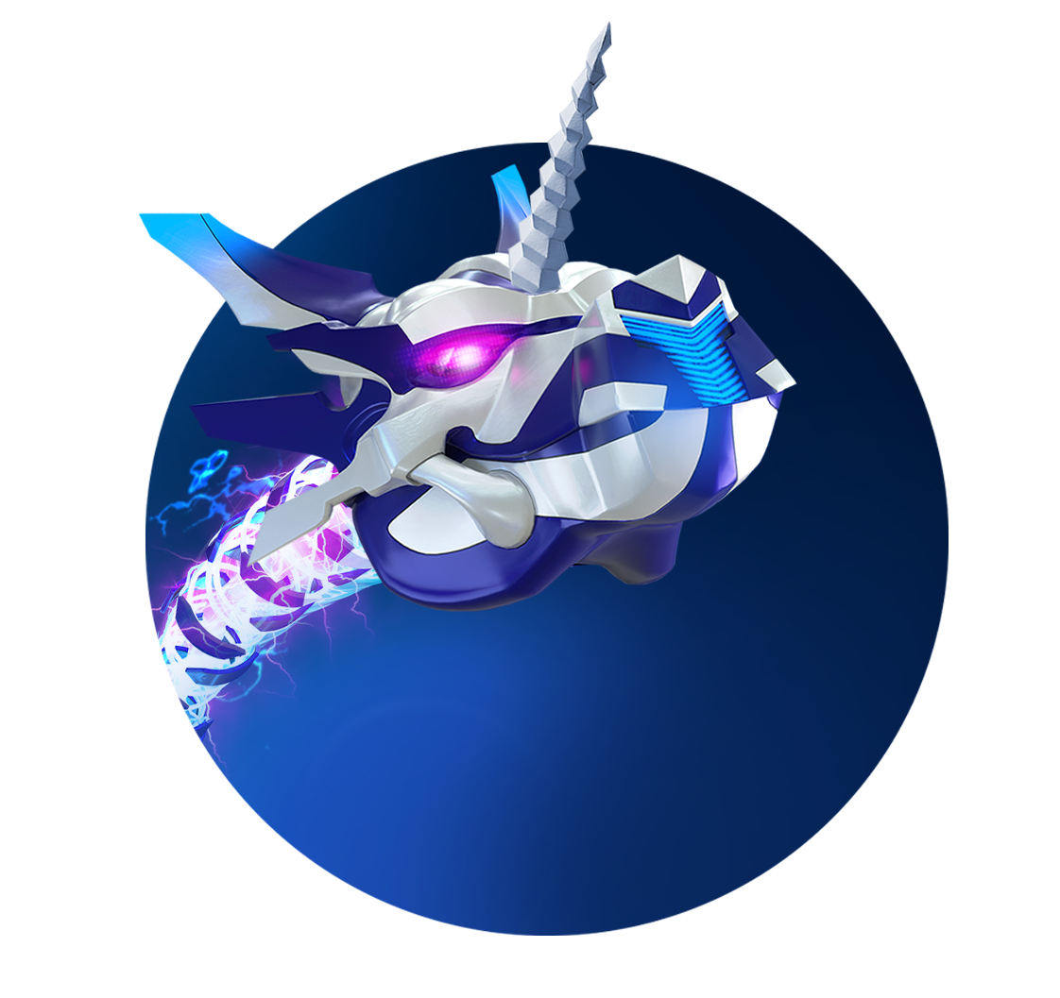
SGD $202M (USD $147M) Investment Round Led by Goldman Sachs
Acquiring companies
Expanding R&D team
Growing the business in North America
Acronis Cyber Dragon “Unicorn”

