Slide 1
Investigating one of the most sensitive sectors #NEXT DIFI 2019 Sofia, 3 October
Online opinion about Bulgaria’s biggest banks
Adam Gulyas
Country Manager
adam.gulyas@neticle.com

Slide 2
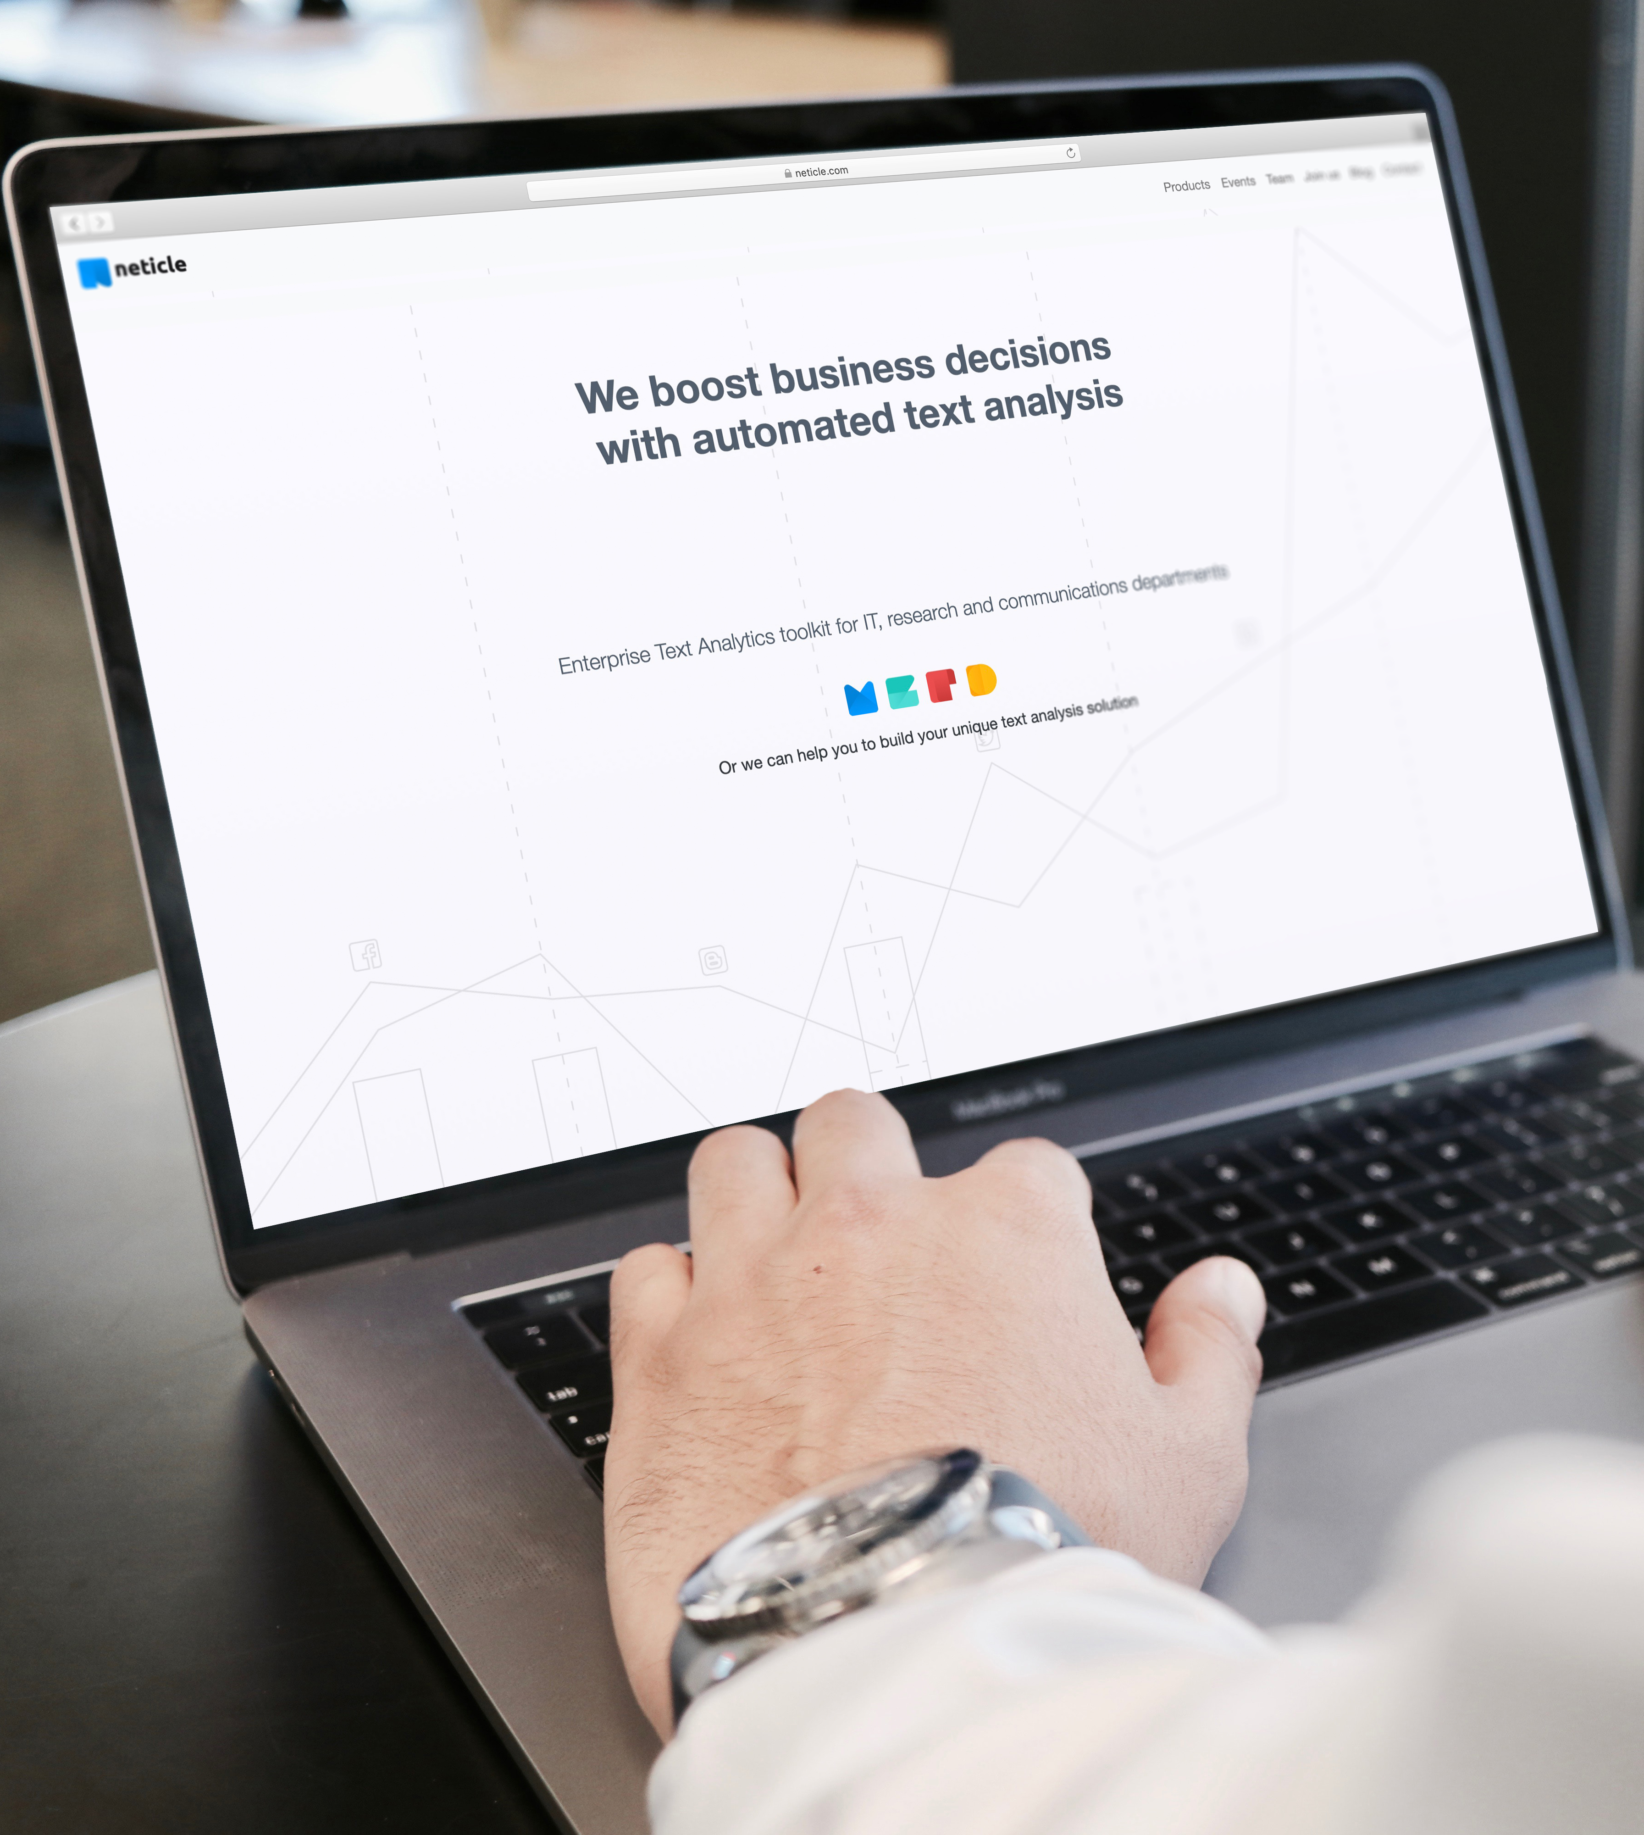
Neticle’s Methodology

Slide 3
The Neticle Story
We do social listening since 2013.
We work together with more than 140 companies.
Many of them are ICT, financial service provider, healthcare company and communication agency.

Slide 4
How it works
1
Data Gathering
2
Searching for Keywords
3
Text Analysis
4
Insights
Full coverage in social media and online news (12 source types)
Own search engines
Working with several data providers to maximize quantity
Real time web monitoring (10-30 minutes)
Monitoring local platforms
Sophisticated keyword modelling (synonyms,filters, excludes)
Collecting every writing mode, uppercase, lowercase
Using smart filters (aspects) to ease filtering
Entity oriented sentiment analysis
Automatic topic recognition algorithms (topics,locations, persons)
User-friendly, interactive interface
Automated root cause detection
Detailed topic visualization
AI supported question interface
Insight engine

Slide 5
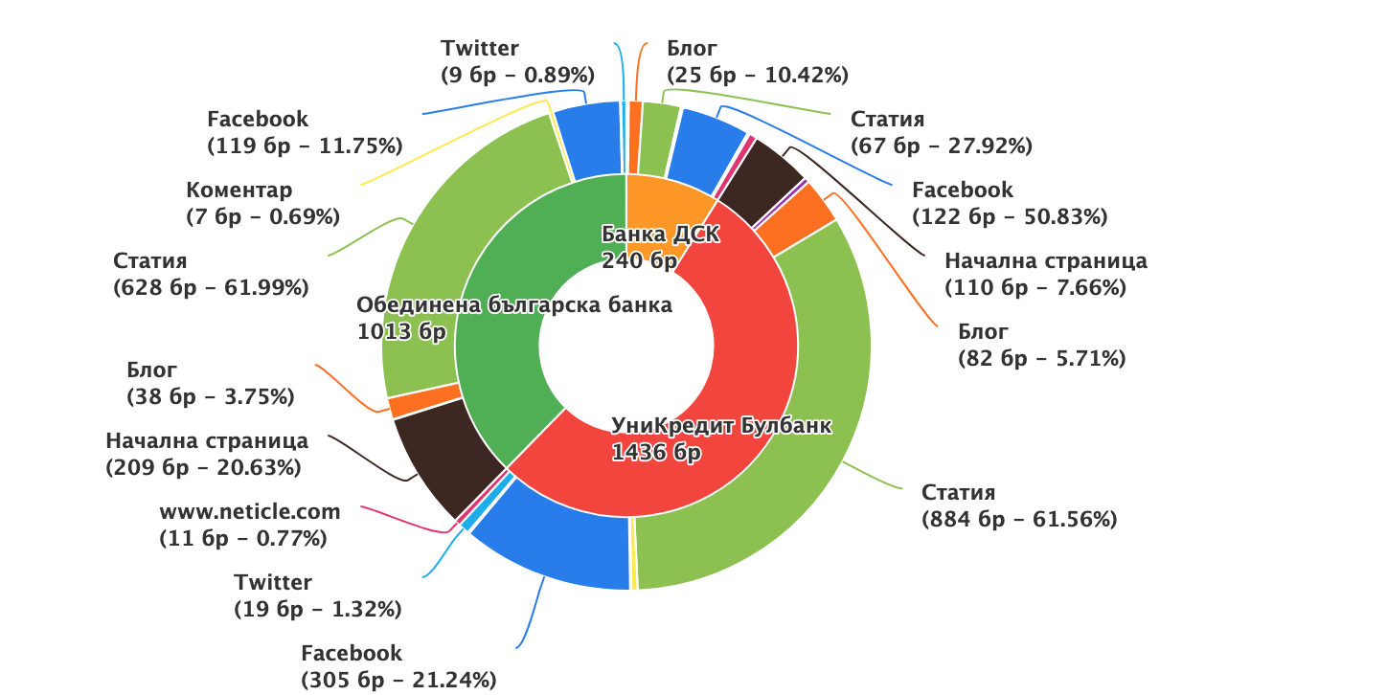
UniCredit got the most of the mentions
UniCredit was mentioned most frequently: 1436 (United: 1013, DSK: 240)
In all cases both press’ and people’s voice played a big role in defining the online reputation.
Notes:
observed Bulgaria’s three bank’s online reputation: DSK Bank, UniCredit Bulbank and United National Bank
examined period: 1st of March 2019 - 26th of September 2019
every type of content that appeared online: articles, cover stories, forum discussions and social media posts and comments and Instagram captions
platform based distribution of these mentions showed that these discussions about the institutes are mostly coming from online articles and Facebook

Slide 6
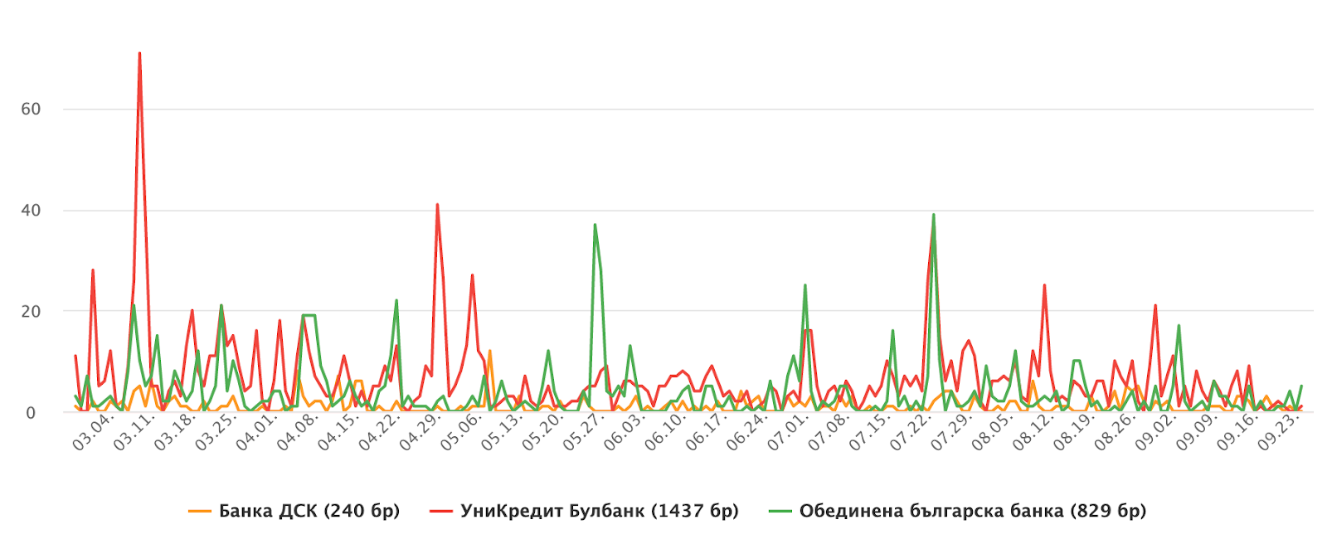
Number of mentions
According to this, United National Bank had one peak during the period.

Slide 7
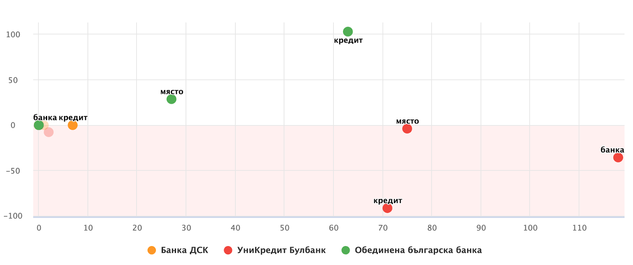
United National Bank benefited from the power of media
The success of United National Bank’s reputation occurred because of several good news about them that were widely covered in Bulgarian press.
The most frequently connecting topic in UniCredit’s was business. It showed up as the most positive as well, since it was all about UniCredit was nominated for the CRIBE Awards.
Notes:
Winning the B2BMedia Annual Awards, becoming the bank of the third biggest loan portfolio in the country and introducing a new loan offer with a fix interest rate of 6% were all welcomed.

Slide 8
Responding fast is key when it comes to client complaints in social media
Even in cases when a client complaint appeared on social media, DSK responded quickly and this act generated more engagement and client satisfaction.

Slide 9
Publicity – friend or foe?
Notes:
All in all, these banks’ stories can be a good example of how publicity can be a friend or a foe as well.
But there is no reason to worry about managing online reputation if we have an intelligent software on our side that helps finding every mention we need to be aware of.

Slide 10
Adam Gulyas
Country Manager
adam.gulyas@neticle.com
+36 30 716 2811

